Slide 1
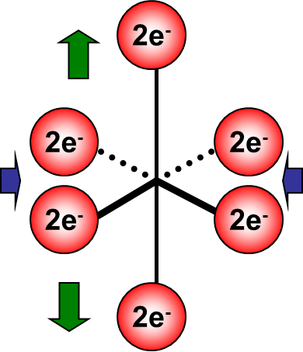
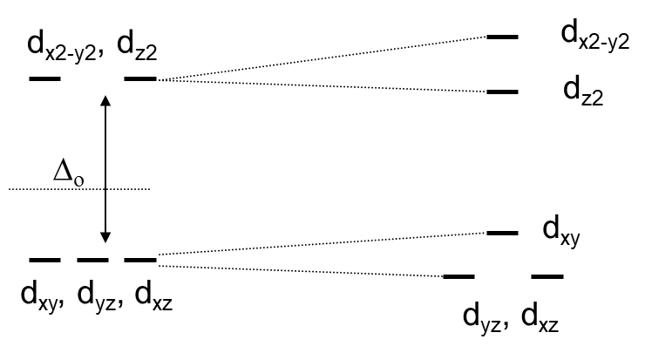
Recap: J-T Distortion
When elongation occurs in the z-direction, simultaneous contraction in the x- and y- direction results from the availability of space around M^{n+}.
The coulombic attraction between the ligand electrons and the charge of the metal center pulls the ligand closer.
What about orbital energy changes?
The barycenter remains constant.
Orbitals with a “z” component become more stable.
Why?…..it’s electrostatics.
Orbitals with “x” and “y” components become less stable.
Distortions will be more pronounced for unsymmetrical population of electrons in the
doubly degenerate (e_{g}) level than triply degenerate (t_{2g}) levels as these orbitals are
directly facing the ligands.

Slide 2
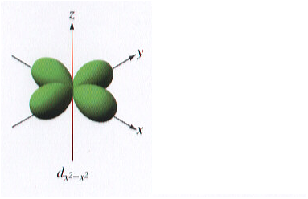
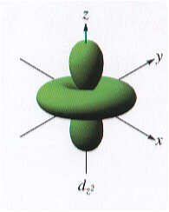
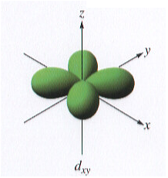
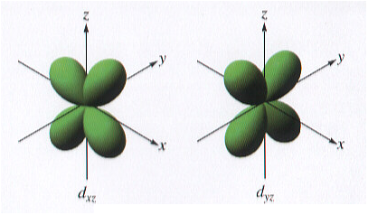
A Summary of the Effects on the Orbital Energies
The d_{x2-y2} orbital is increased in energy because it is directed toward the x- and y- ligands which have approached the M center more closely.
The d_{z2} orbital is decreased in energy because it is directed toward the retreating z- ligands. The change in energy of the d_{z2} orbital is greater than the d_{yz} and d_{xz} because it is directed the elongated positions.
d_{x2-y2}
d_{z2}
The d_{xy} orbital is increased in energy because it is directed toward the x- and y- ligands which have approached the M center more closely. This results in more e-e repulsion between e in the d-orbital and on the ligands.
d_{xy}
d_{yz}, d_{xz}
The d_{yz} and d_{xz} orbitals are decreased in energy because they feel direct influence of the retreating z- ligands. The change in energy of the d_{z2} orbitals is greater than that seen for the d_{yz} and d_{xz} orbitals because it is directed at the elongated positions.

Slide 3
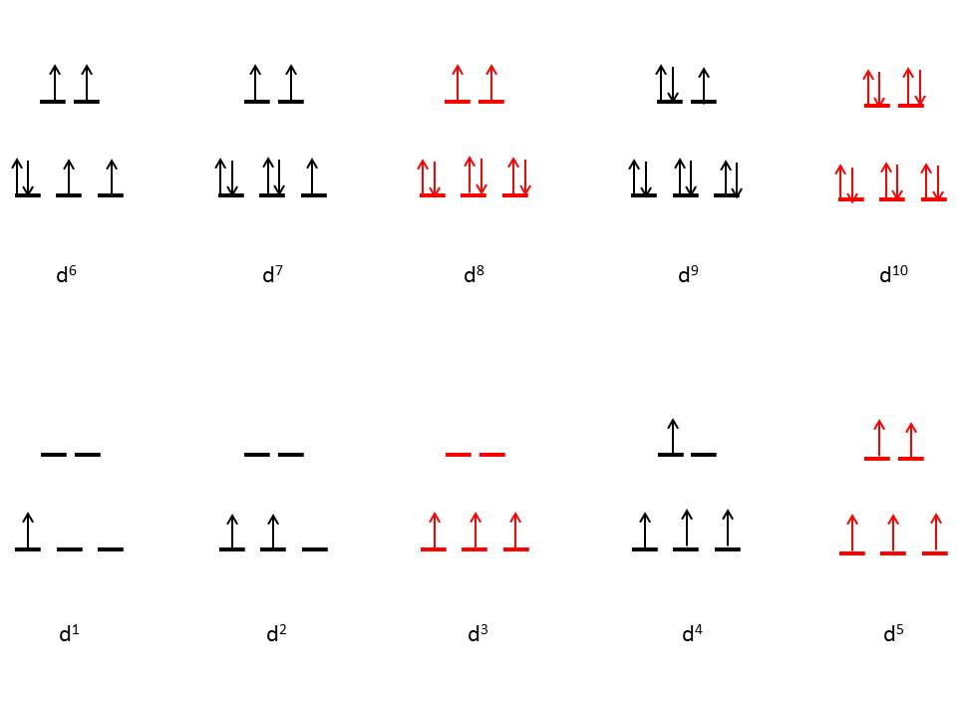
J-T Distortion Possibilities for High-Spin
Octahedral Complexes
According to Jahn-Teller theorem, high spin d³, d⁵, d⁸, and d¹⁰ complexes wont exhibit
distortion because there is no electronic degeneracy.

Slide 4
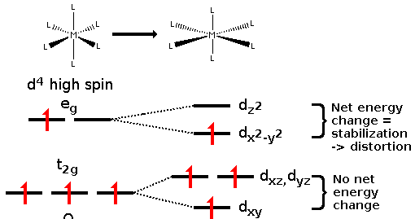
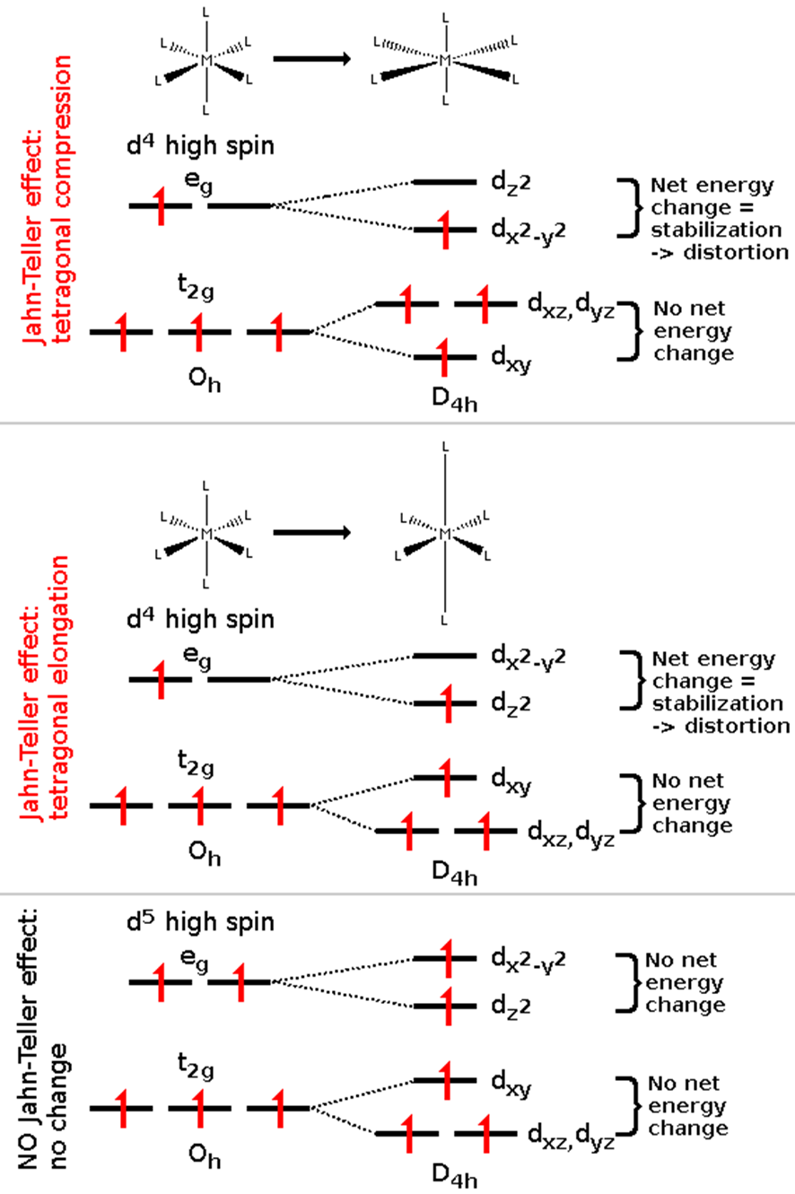

Not All Complexes Exhibit J-T Distortion
Jahn-Teller Effect: Tetragonal Compression
Jahn-Teller Effect: Tetragonal Elongation
NO Jahn-Teller Effect: No change
Limitation of Jahn-Teller Theorem: For certain configurations, it cannot predict the
type of distortion

Slide 5
Will a d² system Exhibit Compression or Elongation?

Slide 6
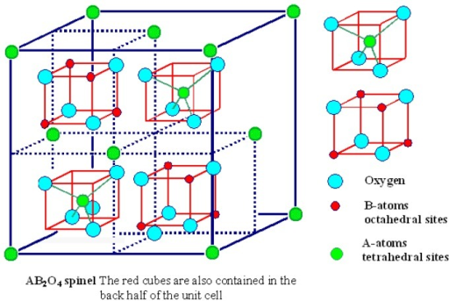
Spinel Structures and CFT
Spinel is MgAl₂O₄
Many compounds adopt this type of structure. The general spinel structure is written as (M²⁺)(2M³⁺)(O²⁻)_{4.}
The basic structure is a FCC lattice of O²⁻ anions.
Cations occupy tetrahedral and octahedral holes.

Slide 7
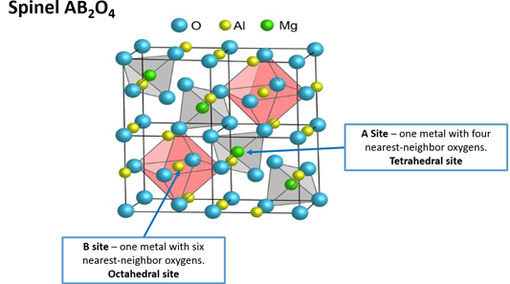
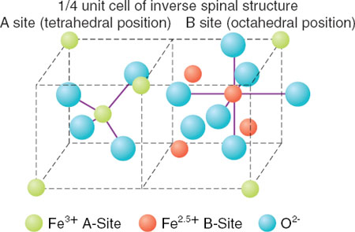
General Features of Spinel Structures
Normal Spinels:(A^{II})_{tet}(B^{III}₂)_{oct}O₄
The divalent A^{II} ions occupy the tetrahedral voids, whereas the trivalent B^{III} ions occupy the
octahedral voids in a close packed arrangement of oxide ions.
MnAl₂O₄, Mn₃O₄, ZnFe₂O₄, FeCr₂O₄
Inverse Spinels: (B^{III})_{tet}(A^{II}B^{III})_{oct}O₄
The A^{II} ions occupy the octahedral voids, whereas half of B^{III} ions occupy the tetrahedral voids.
Fe3O4, CoFe2O4, NiFe2O4, NiAl2O4

Slide 8
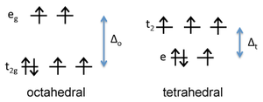
CFT Can Explain Structural Preferences
The choice of the normal vs. inverse spinel structure is driven primarily by the crystal field stabilization energy (CFSE) of ions in the tetrahedral and octahedral sites.
For spinels that contain 3d elements such as Cr, Mn, Fe, Co, and Ni, the electron configuration is typically high spin because O²⁻ is a weak field ligand.
As an example, we can consider magnetite, Fe₃O₄. This compound contains one Fe²⁺ and two Fe³⁺ ions per formula unit, so we could formulate it as a normal spinel, Fe²⁺(Fe³⁺)₂O₄, or as an inverse spinel, Fe³⁺(Fe²⁺Fe³⁺)O₄. Which one would have the lowest energy?
First we consider the crystal field energy of the Fe²⁺ ion, which is d⁶.
Comparing the tetrahedral and high spin octahedral diagrams, we find that the CFSE in an octahedral field of O²⁻ ions is
[-(4)(2/5) + (2)(3/5)]Δ_{o} = - 0.4 Δ_{o}
d-orbital energy diagram for Fe²⁺

Slide 9
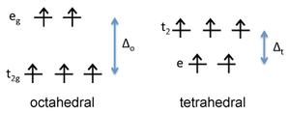
CFT Can Explain Structural Preferences
In the tetrahedral field, the CFSE for Fe⁺² is
[-(3)(3/5) + (3)(2/5)]Δ_{t} = - 0.6 Δ_{t}
Since Δ_{o} is about 2.25 times larger than Δ_{t}, the octahedral arrangement has a larger CFSE and is preferred for Fe²⁺.
d-orbital energy diagram for Fe²⁺
What about the Fe³⁺ ions?
Fe³⁺, which is d⁵, would have a CFSE of zero in either
the octahedral or tetrahedral geometry.
d-orbital energy diagram for Fe³⁺
This means that Fe²⁺ has a preference for the octahedral site, but Fe³⁺ has no preference.
Consequently, it is energetically favourable for Fe²⁺ to occupy octahedral sites and Fe₃O₄ is an inverse spinel, Fe³⁺(Fe²⁺Fe³⁺)O_{4.}

Slide 10
Analysis for NiFe₂O₄
Ni is in +2 oxidation state and has 8 electrons in the dorbitals
In a tetrahedral void,
Configuration e⁴t₂⁴; CFSE = - 0.8 Δ_{t} (- 0.4 Δ_{o})
In an octahedral void,
Configuration t_{2g}⁶e_{g}²; CFSE = - 1.2 Δ_{o}
Fe is in +3 oxidation state and has 5 electrons in the d-orbitals
In a tetrahedral void,
Configuration e₂t₂³; CFSE = 0
In an octahedral void,
Configuration t_{2g}³e_{g}²; CFSE = 0
Hence, it is advantageous to have Ni²⁺ ion in the octahedral voids. This results in an inverse spinel structure for the compound. Fe^{III}[Ni^{II}Fe^{III}]O₄
Remember: Normal Spinels:(A^{II})_{tet}(B^{III}₂)_{oct}O_{4;} Inverse Spinels: (B^{III})_{tet}(A^{II}B^{III})_{oct}O₄

Slide 11
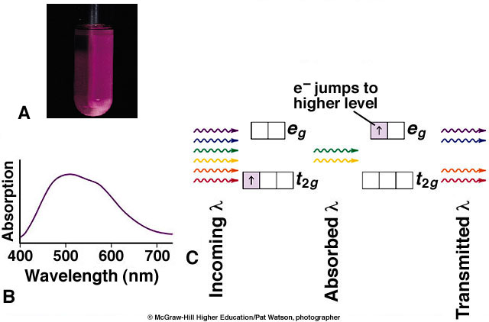
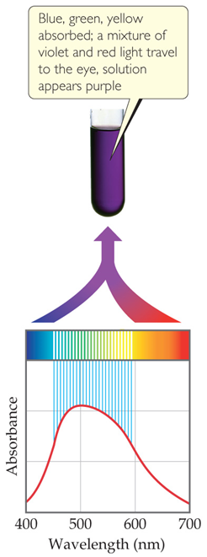
Electronic Spectra
[Ti(H₂O)₆]³⁺
Such transitions are referred to as d-d transitions

Slide 12
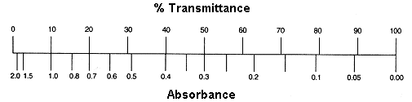
Absorption Spectroscopy
hν
hν
Sample
We don’t measure absorbance. We measure transmittance.
Sample
Transmittance:
T = P/P₀
P₀
P
Absorbance:
A = -log T = log P₀/P
(power in)
(power out)

Slide 13
The Beer-Lambert Law
The Beer-Lambert Law (λ specific):
A = ε c l
Sample
A = absorbance (unitless, A = log₁₀ P₀/P)
ε = molar absorptivity (L mol⁻¹ cm⁻¹)
l = path length of the sample (cm)
c = concentration (mol/L or M)
P₀
P
(power in)
(power out)
l in cm
Concentration
Absorbance
Path length
Absorbance
Molar Abs.
Absorbance

Slide 14
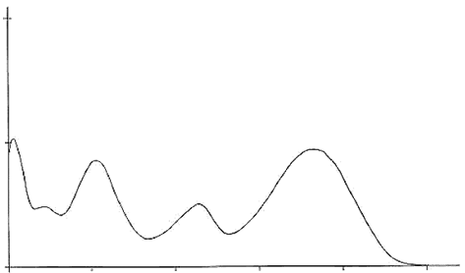
Information Contained in an Electronic Spectra
Spectral Features:
Number of transitions.
Energy of the transitions.
Intensity of the transitions.
ε
100
200
300
400
500
Wavelength (nm)

Slide 15
What do the Number of Peaks Indicate?
More than one electronic transition may be possible .
hν
A hypothetical scenario is depicted on the right.
hν
ε
100
200
300
400
500
Wavelength (nm)
hν

Slide 16
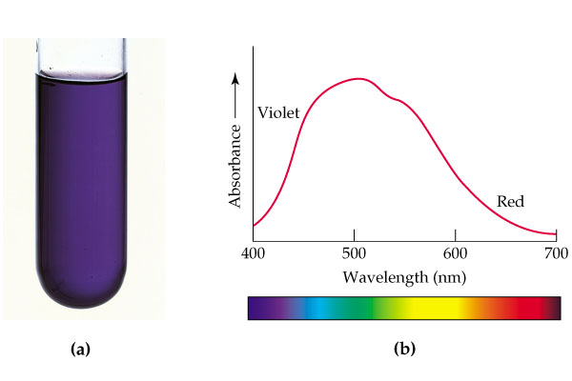
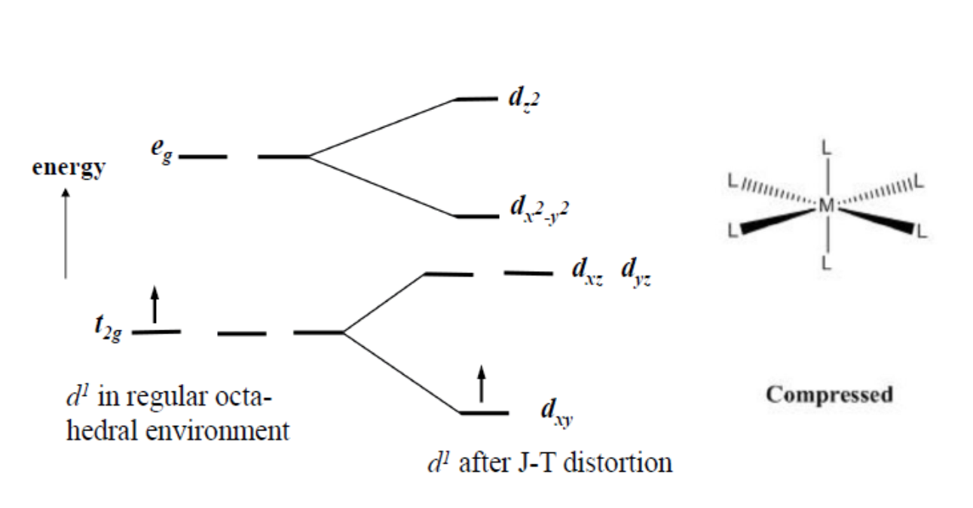
Even Seemingly Simple Systems May Exhibit
More than One Transition
The case of [Ti(H₂O)₆]³⁺, a d¹ system
Looking closely at the spectra, we will see that there is a “shoulder” in the peak.
It indicates two transitions which are close in energy.
Since the energies of these transitions are similar, the peaks appear very close to each other.

Slide 17
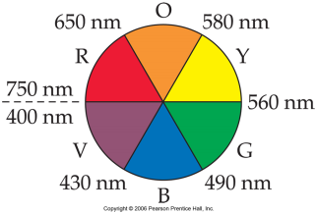
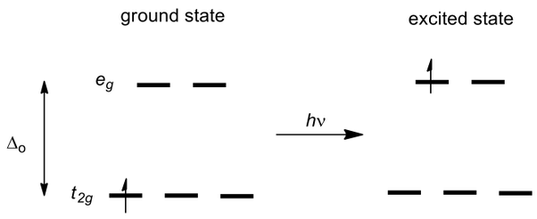


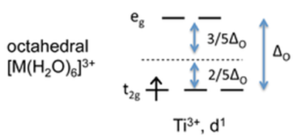
Energy of the Transitions: Δ is Relatable to Colour
[Ti(H₂O)₆]³⁺ is a d¹ complex. The single electron in the t_{2g} orbitals absorb energy in the form of light and gets promoted to the e_{g} orbitals to show it’s purple color.
For [Ti(H₂O)₆]³⁺, this corresponds to 493 nm (Δ_{o} = 20,300 cm⁻¹ = 243 kJ/mol).
For t_{2g}¹e_{g}⁰ configuration:
stabilization energy = 243 x 0.4 = 97 kJ/mol,
this extra stabilization due to the splitting of d-orbitals called
crystal field stabilization energy (CFSE).

Slide 18
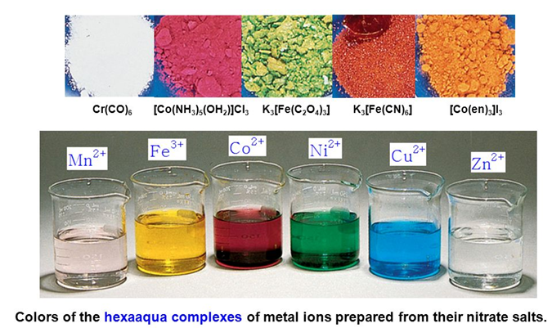
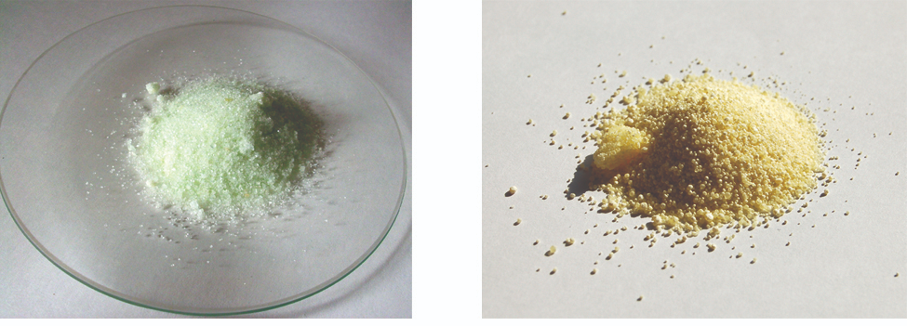
Why are Intensities of Colours Different
[Fe(H₂O)₆]SO₄
K₄[Fe(CN)₆]
Intensity is related to the “probability” of a transition.
The value of ε is indicative of this probability.
The probability is also referred to as a transition either being “allowed” or “forbidden”.
The Beer-Lambert Law (λ specific):
A = absorbance (unitless, A = log₁₀ P₀/P)
ε = molar absorptivity (L mol⁻¹ cm⁻¹)
l = path length of the sample (cm)
c = concentration (mol/L or M)
A = ε c l

Slide 19
Selection Rules
Selection rules determine the probability (intensity) of the transition.
Symmetry (Laporte) Selection Rule: The initial and final wavefunctions (or the orbitals involved) must change in parity. Parity is related to the orbital angular momentum summation over all elections Σl_{i}, which can be even or odd; only even ↔ odd transitions are allowed.
Also Δl = ± 1 .
Spin Selection Rule: There must be no change in the spin multiplicity (ΔS = 0) during the transition.
i.e. the spin of the electron must not change during the transition.

Slide 20
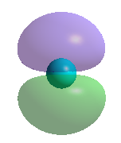
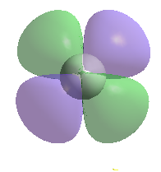
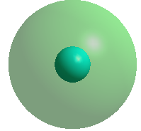
Symmetry (Laporte) Selection Rules
Symmetry (Laporte) Selection Rule: The initial and final wavefunctions must change in parity. Parity can be even or odd; only even ↔ odd transitions are allowed. Also, Δl = ± 1 .
Orbital parity is notated as “g” and “u” (for even and odd in German)
Orbitals are of even parity (g) if the phase sign does not change on inversion
Orbitals are of odd parity (u) if the phase sign changes on inversion
a
not a
center of inversion
a ≠ b
a
center of
inversion
a = b
b
b
s-orbital p-orbital d-orbital
gerade (g) ungerade (u) gerade (g)
Hence, the Laporte selection rule implies that d-d transitions are forbidden (while d-p, p-d are allowed)

Slide 21
Symmetry (Laporte) Selection Rules
A photon has 1 unit of angular momentum
When a photon is absorbed or emitted, this momentum must be conserved
Δl = ±1 or:
‘s ↔ p’, ‘p ↔ d’, ‘d ↔ f’ etc allowed (Δl = ±1)
‘s ↔ d’, ‘p ↔ f’ etc forbidden (Δl = ±2)
‘s ↔ s’, ‘p ↔ p’ , ‘d ↔ d’, ‘f ↔ f’ etc forbidden (Δl = 0)
…so why do we see ‘d-d’ bands?
Notes:
Very important equation - one that you need to remember
surely this should depend on the gas ? … No, as we’ll see soon

Slide 22
‘Relaxing’ The Orbital Selection Rule
The selection rules are exact and cannot be circumnavigated
It is our model which is too simple:
the ligand-field transitions described so far are not between point charges but between in molecules
labelling the orbitals as ‘d’ (atomic orbitals) is incorrect if there is any covalency
For tetrahedral complexes, there can be mixing of d and p orbitals
through covalency
A metal p-orbital overlaps with ligand orbitals
A metal d-orbital overlaps with the same ligand orbitals
Notes:
Very important equation - one that you need to remember
surely this should depend on the gas ? … No, as we’ll see soon

Slide 23
‘Relaxing’ The Orbital Selection Rule
This way of ‘relaxing’ the orbital selection rule is not available in octahedral complexes
in phase
no overlap
out of phase
A metal p-orbital overlaps with ligand orbitals
A metal d-orbital cannot overlap with the same ligand orbitals
In general, no mixing of the ‘d’ and ‘p’ orbitals is possible if the molecule has a centre of inversion (Laporte rule)
Notes:
Very important equation - one that you need to remember
surely this should depend on the gas ? … No, as we’ll see soon

Slide 24
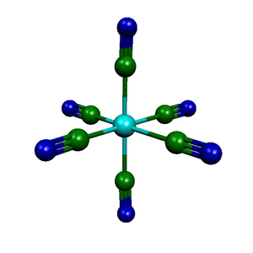
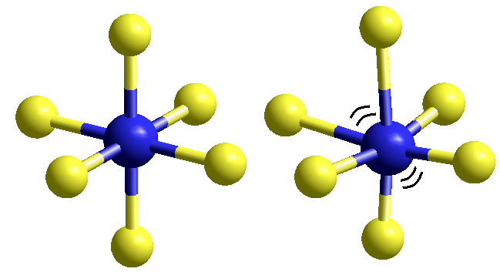
Symmetry (Laporte) Selection Rules
Then why are octahedral complexes coloured?
Again our model is deficient:
molecules are not rigid but are always vibrating
During this vibration, centre of inversion is temporarily lost:
d-p mixing can occur
Vibrational amplitude is small so deviation and mixing is small:
octahedral complexes have lower intensity bands than tetrahedral complexes
the intensity of the bands increases with temperature as amplitude increases
Notes:
Very important equation - one that you need to remember
surely this should depend on the gas ? … No, as we’ll see soon

Slide 25
Spin Selection Rule
The spin cannot change during an electronic transition
d⁴
e_{g}
e_{g}
e_{g}
Only one spin allowed transition
t_{2g}
t_{2g}
t_{2g}
ground state
1st excited state
2nd excited state
Notes:
Very important equation - one that you need to remember
surely this should depend on the gas ? … No, as we’ll see soon

Slide 26
The Spectra of High-Spin d⁵ Ions
For high-spin d⁵ ions all possible d-d transitions are spin-forbidden.
As a result, the bands in spectra of high-spin complexes of Mn(II) and Fe(III) are very weak, and the compounds are nearly colorless.
Below is shown a d-d transition for a high-spin d⁵ ion, showing that it is spin-forbidden.
e_{g}
e_{g}
energy
Spin forbidden
t_{2g}
t_{2g}

Slide 27
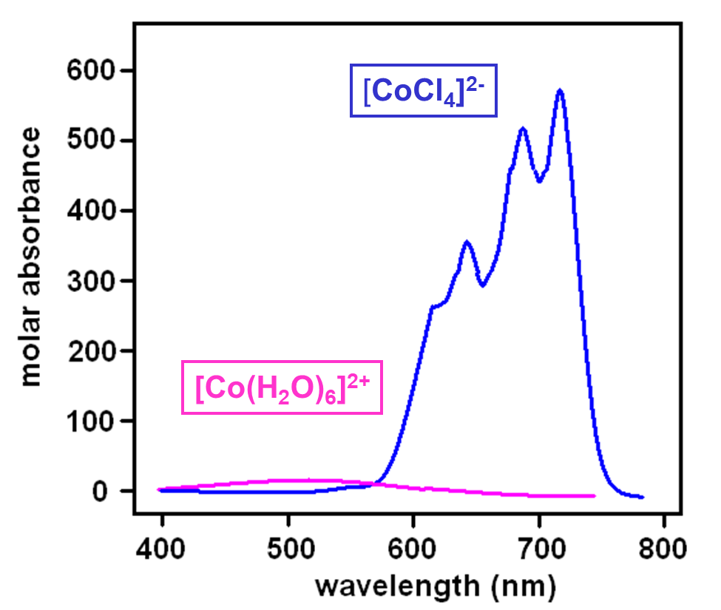
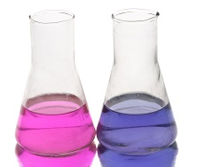
Case in Point: Tetrahedral vs Octahedral Complexes
As we have seen, a tetrahedron has no center of symmetry, and so orbitals in such symmetry cannot be gerade. Hence the d-levels in a tetrahedral complex are e and t₂, with no ‘g’ for gerade.
This largely overcomes the Laporte selection rules (enabled by d-p mixing), so that tetrahedral complexes tend to be more intense in color than octahedral.
Thus, we see that dissolving CoCl₂ in water produces a pale pink solution of [Co(H₂O)₆]²⁺, but in alcohol tetrahedral [CoCl₂(CH₃CH₂OH)₂] forms, which is a very intense blue color.

